Slide 1
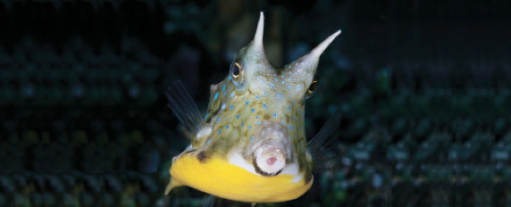
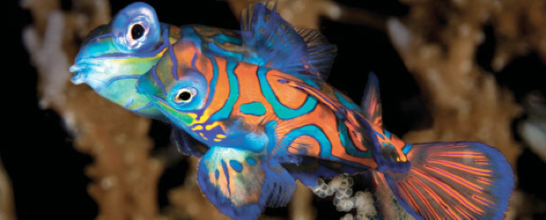
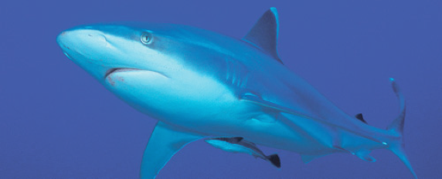
Lesson 8 Taxonomy II
Ichthyology
Shanghai Ocean University
Fall, 2022

Slide 2
Ostariophysans
倪婧方
What traits that the ostariophysans have, which made this group so successful?

Slide 3
Ostariophysi
Contains predominantly freshwater fishes such as milkfishes, minnows, suckers, characins, loaches, catfishes, and South American knifefishes.
Ostariophysans have modified anterior vertebrae, making up the Weberian apparatus that aids in hearing (absent in the more primitive Anotophysi). They produce and respond to alarm substances (Schreckstoff).
Cypriniforms possess pharyngeal jaws and dentition used in manipulating and crushing prey and vegetation. Characins are highly successful South American and African fishes such as piranhas and tetras. Siluriform catfishes include 35 families of primarily benthic, nocturnal fishes with barbels, spines, and adipose fins. Gymnotiform knifefishes have converged with the osteoglossomorph elephantfishes in the production and detection of weak electric fields.

Slide 4
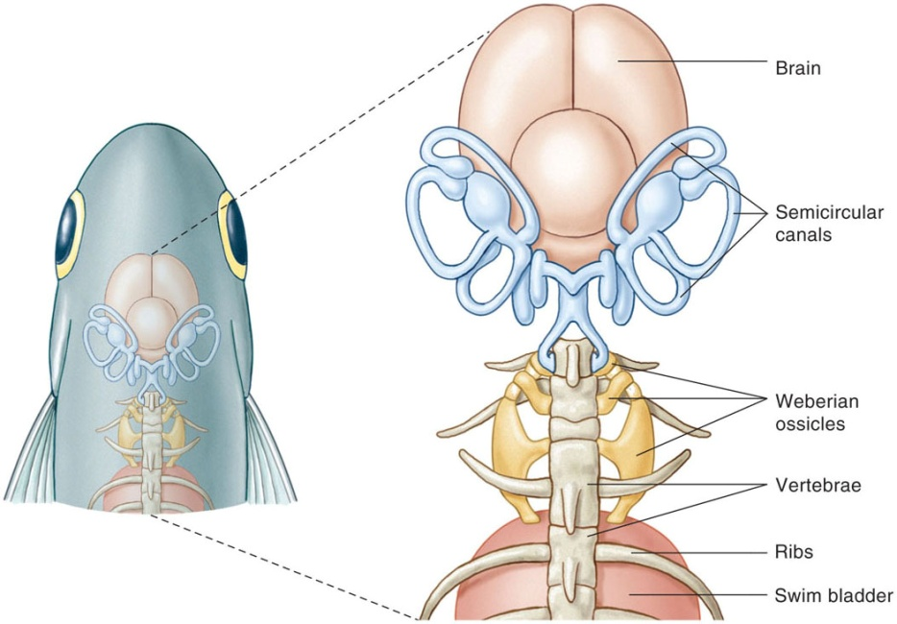

Slide 5
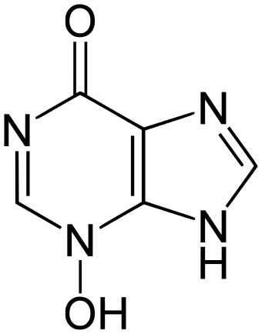
Schreckstoff

Slide 6
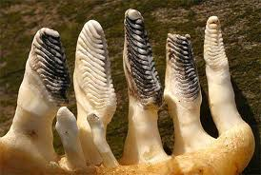
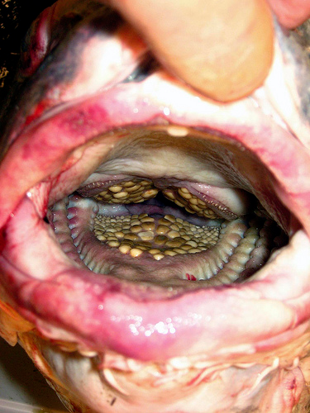
Pharyngeal teeth from grass carp
Pharyngeal teeth from black carp

Slide 7
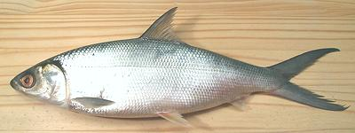
Gonorhynchiformes
Chanos chanos 遮目鱼 (milkfish)
Why is it called milkfish?
When cooked, the FLESH IS AS WHITE AS MILK

Slide 8
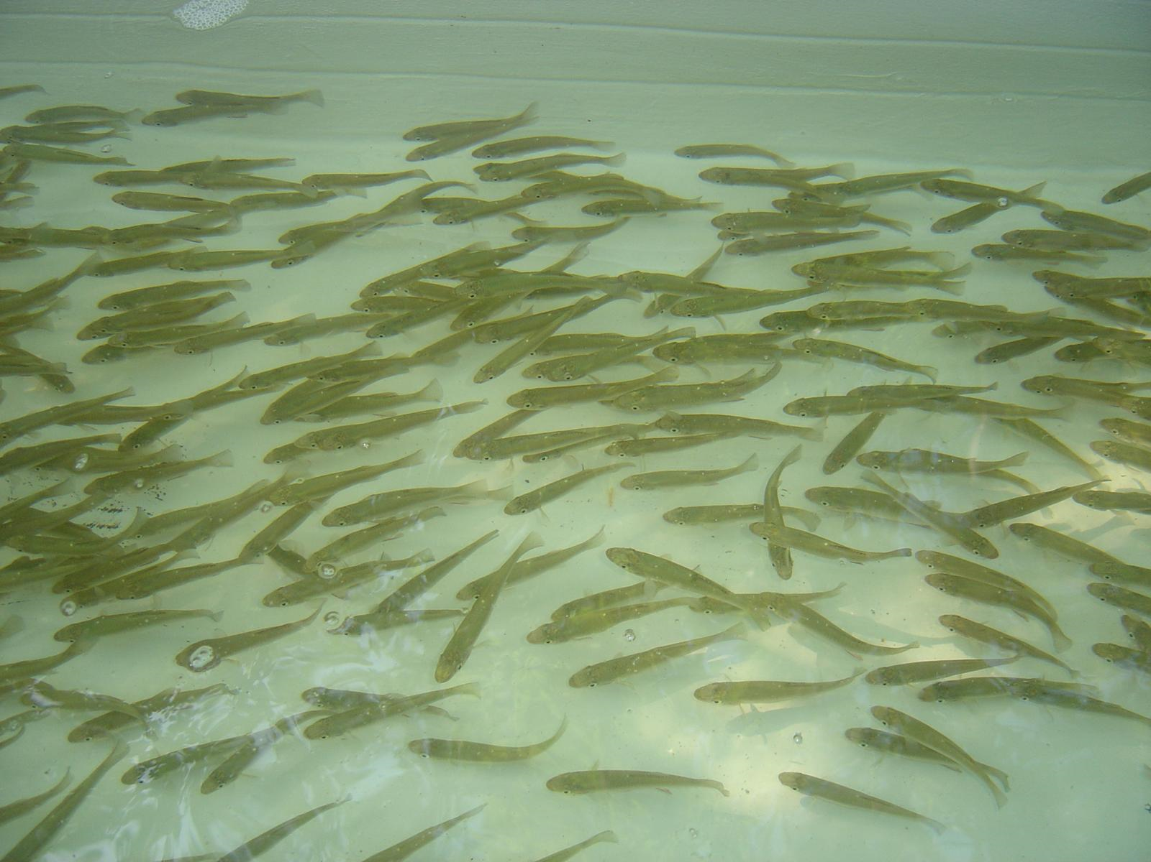
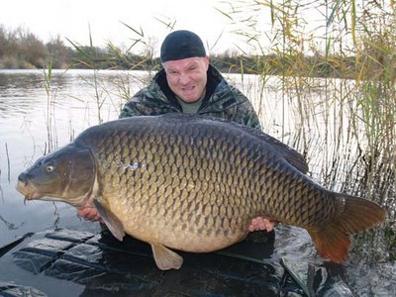
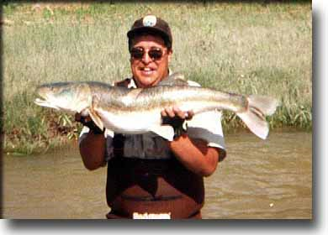
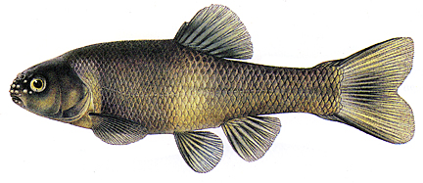
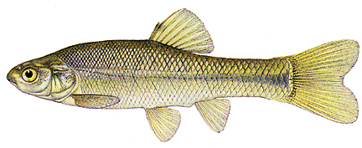
Order Cypriniformes
(”The Minnows and Suckers”)
HUGE family – more than 2000 species
Most common family in North America and Asia
Pharyngeal teeth, but no teeth on protractile jaw
>>>variety of feeding modes
Great variation in size: 3 mm >>> 3 meters
Conspicuous secondary sexual characters during spawning season

Slide 9
Cypriniforms
???
Describe common cypriniforms in China, names (English/Chinese), pictures, and characteristics

Slide 10
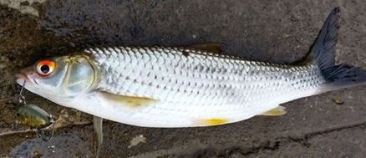
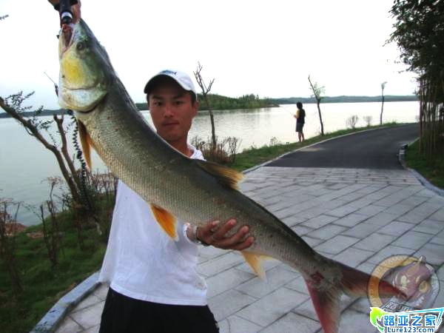
Cyprinidae (鲤科)
Leuciscinae 雅罗鱼亚科
Squaliobarbus curriculus 赤眼鳟；Elopichthys bambusa 鱤鱼；Opsariichthys uncirostris 马口鱼；Mylopharyngodon piceus 青鱼 (black carp)；Ctenopharyngodon idellus 草鱼 (grass carp)；Leuciscus waleckii 瓦氏雅罗鱼

Slide 11
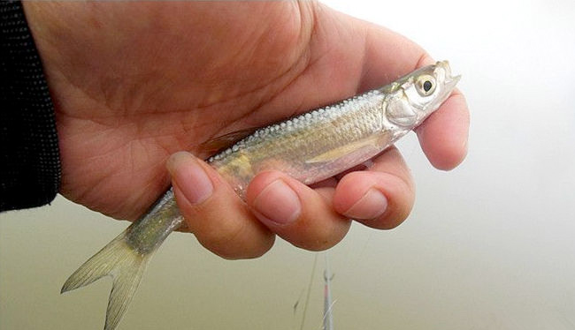
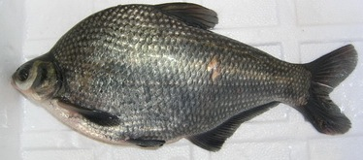
Cyprinidae (鲤科)
Abramidinae 鳊亚科
Hemiculter leuciscuius 餐条；Culter erythropterus 红鳍鲌；Megalobrama amblycephala 团头鲂；Erythroculter ilishaeformis 翘嘴红鲌

Slide 12
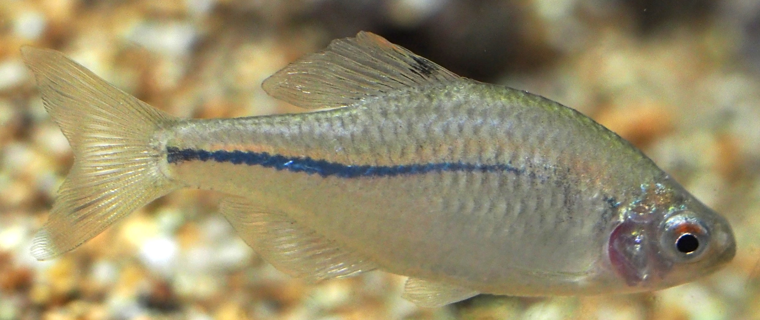
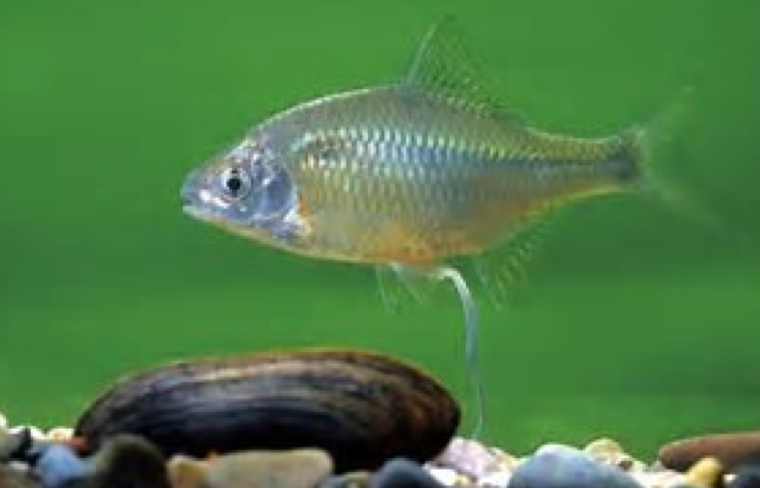
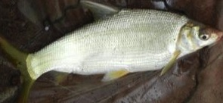
Cyprinidae (鲤科)
Xenocyprinae 鲴亚科
Xenocypris argentea 银鲴；Plagiognathops microlepis 细鳞斜颌鲴
Acheilognathinae 鳑鲏亚科
Rhodeus sinensis 中华鳑鲏
Xenocypris argentea
Rhodeus sinensis (bitterling)

Slide 13
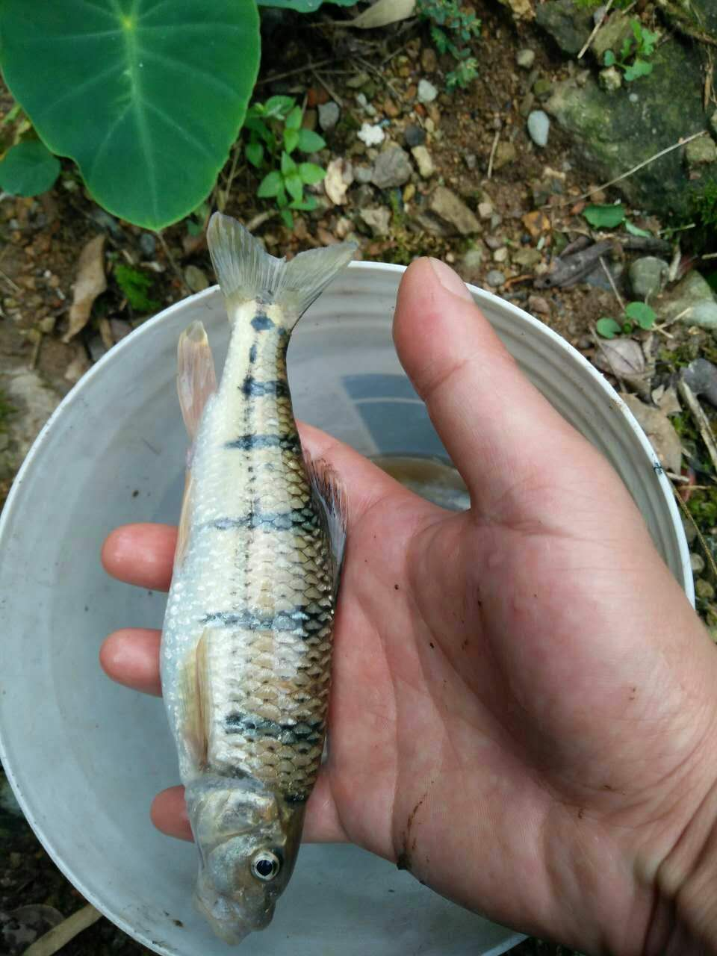
Cyprinidae (鲤科)
Barbinae 鲃亚科
Barbodes denticulatus 倒刺鲃；Acrossocheilus fasciatus 光唇鱼；Varicorhinus simus 白甲鱼；Cirrhinus molitorella 鲮鱼
Varicorhinus simus
Acrossocheilus fasciatus

Slide 14
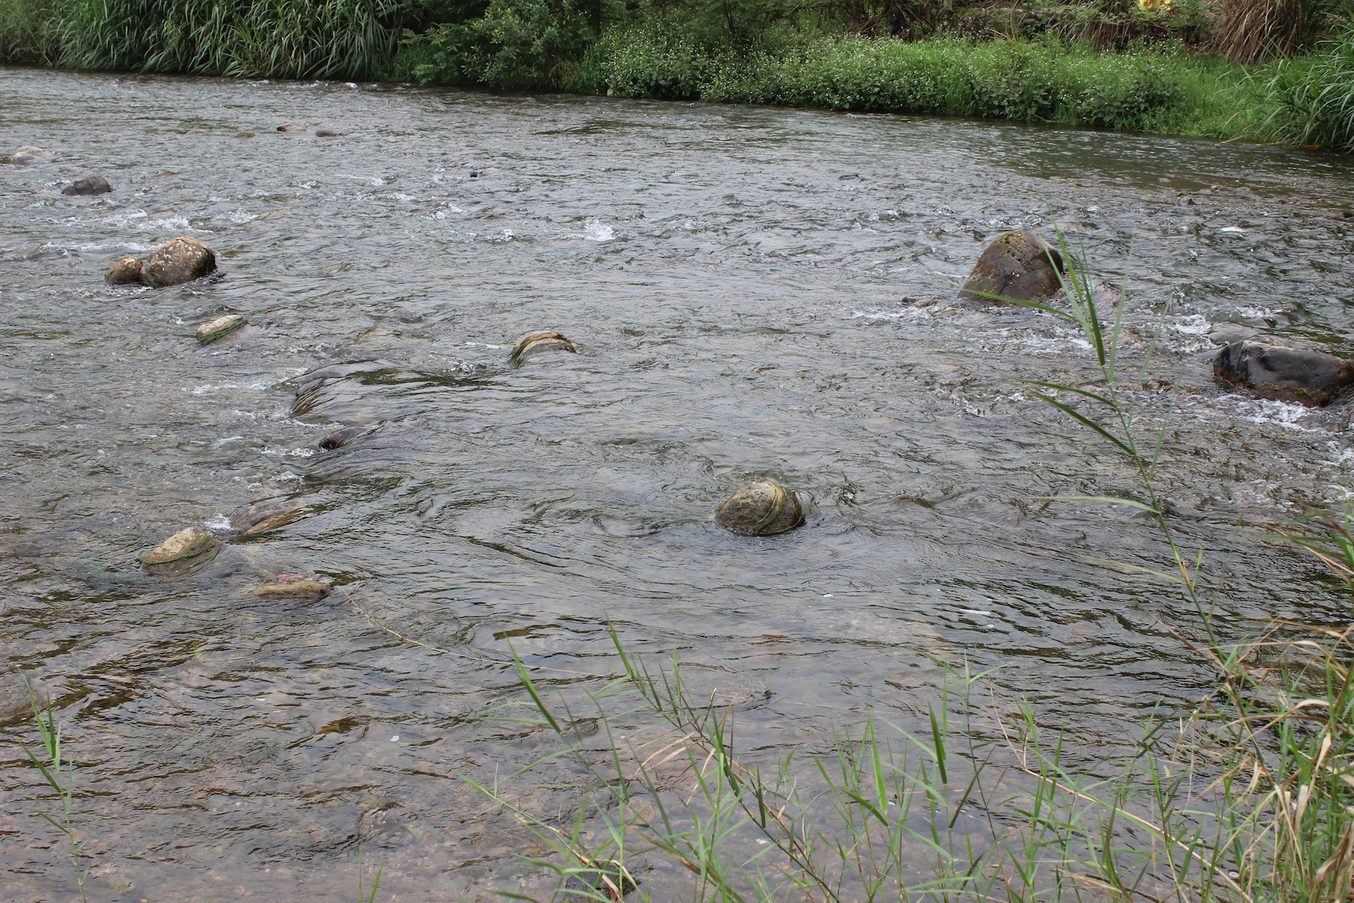
广西，百寿乡

Slide 15
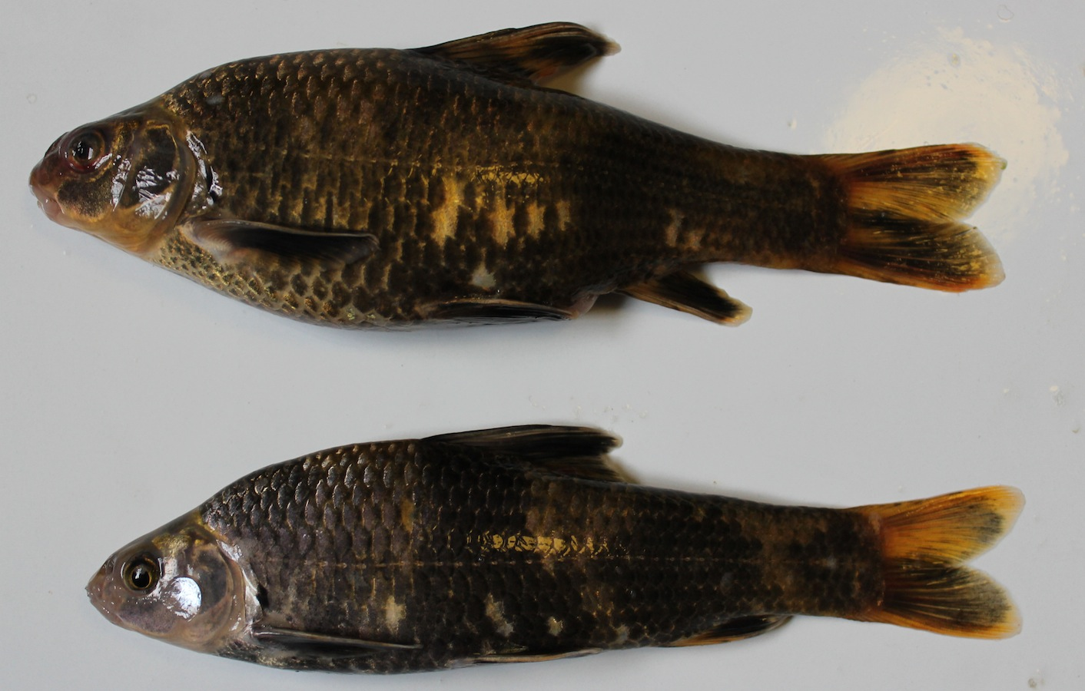
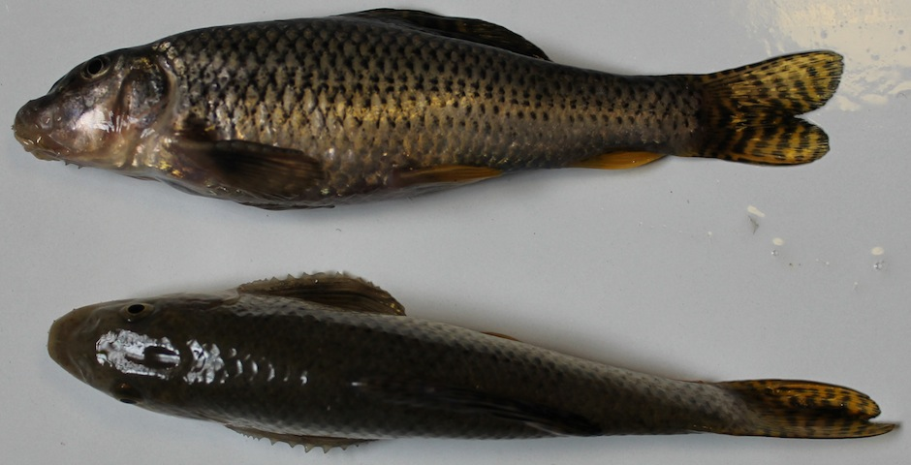
Cyprinidae (鲤科)
Gobioninae 鮈亚科
Hemibarbus maculatus 花（鱼骨）；Pseudorasbora parva 麦穗鱼；Abbottina revularis 棒花鱼；Sarcocheilichthys snensis 华（鱼泉）

Slide 16
Cyprinidae (鲤科)
Schizothoracinae 裂腹鱼亚科
Gymnocypris przewalskii 青海湖裸鲤
Platypharodon extremus 极边扁咽齿鱼
Platypharodon extremus 极边扁咽齿鱼

Slide 17
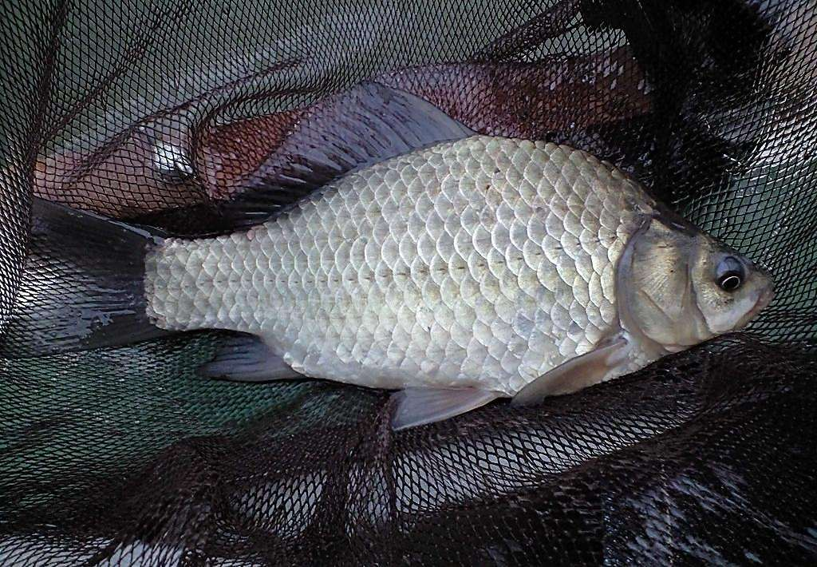
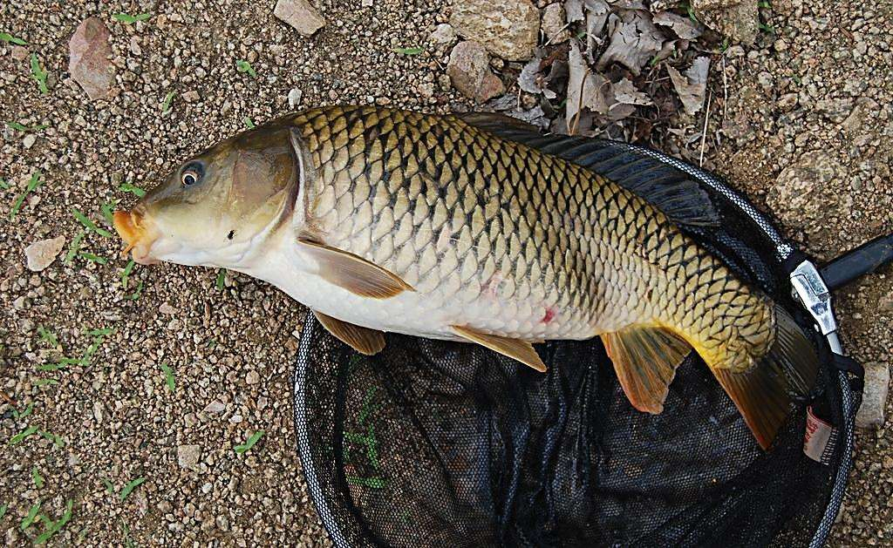
Cyprinidae (鲤科)
Cyprininae 鲤亚科
Cyprinus carpio 鲤 (common carp)；
Carassius auratus 鲫 (goldfish/crucian carp)

Slide 18
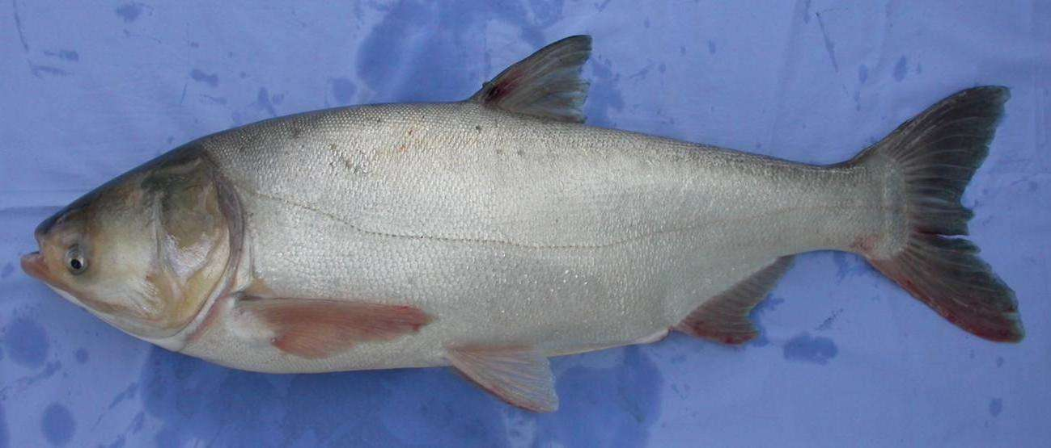
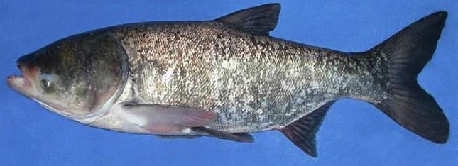
Cyprinidae (鲤科)
Hypothalmichthyinae 鲢亚科
Hypophthalmichthys molitrix 鲢 (silver carp)；
Aristichthys nobilis 鳙 (bighead carp)

Slide 19
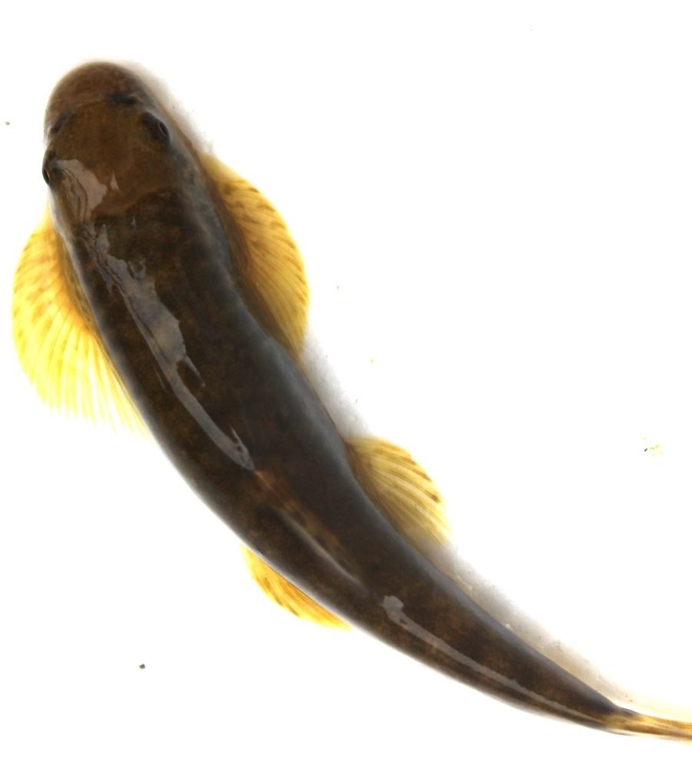
Homalopteridae 平鳍鳅科

Slide 20
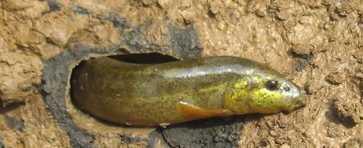
Cobitidae 鳅科
Misgurnus onguillicaudatus 泥鳅 (weather loach)；
Leptobtia elongata 长薄鳅

Slide 21
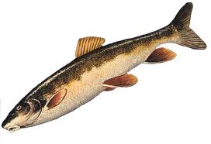
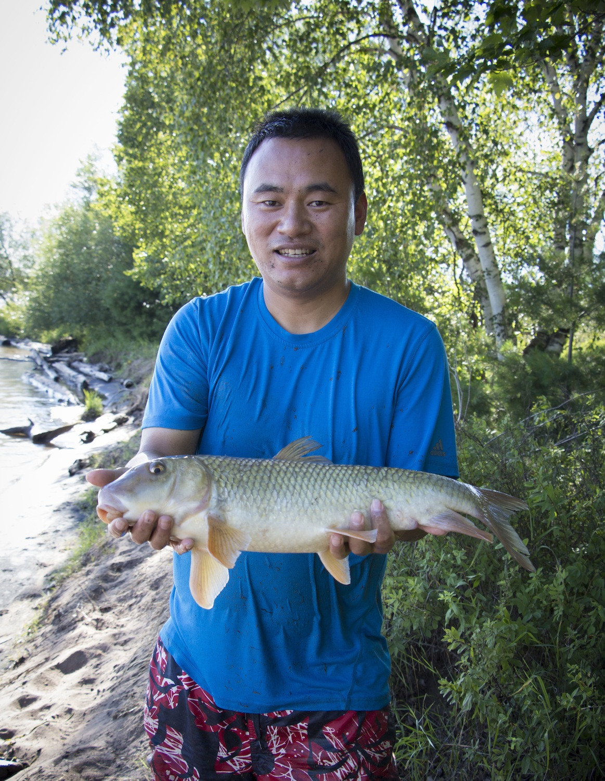
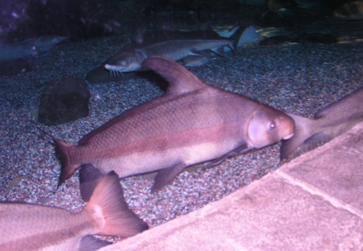
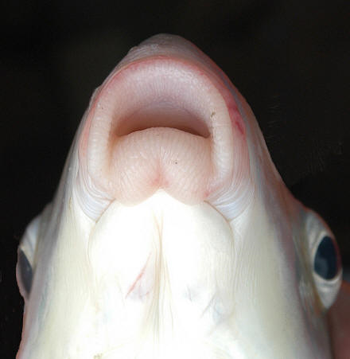
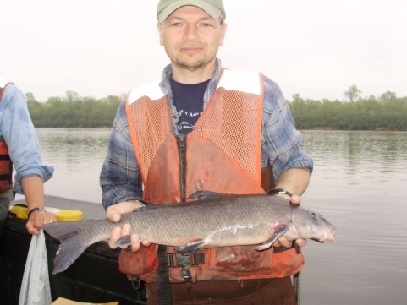
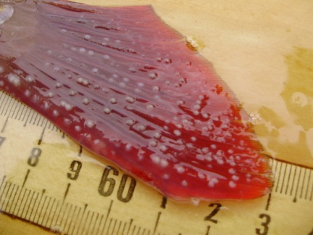
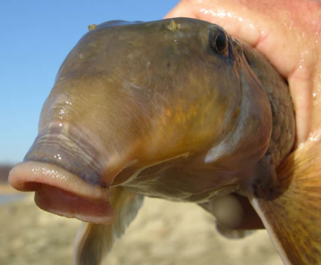
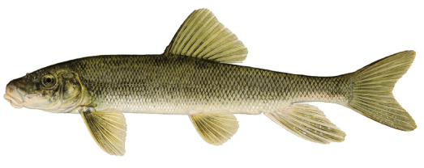
Family Catostomidae (”The Suckers”)
亚口鱼目
Much smaller family – approx. 70 species
All but two exclusively North American
Subterminal mouth, fleshy lips, benthic feeders
Widespread and abundant in North America
Why? More tolerant than many other fishes
Benthic feeding habits (non-specific)
“Trash fish” is misnomer; these are remarkable fishes!
Longnose sucker
Asian high-fin sucker
胭脂鱼

Slide 22
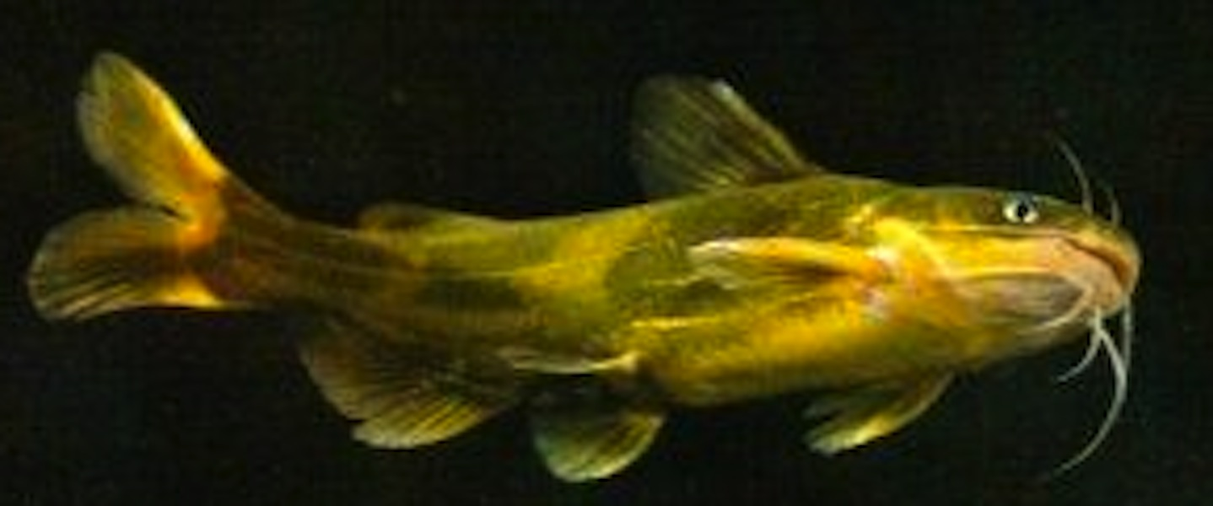
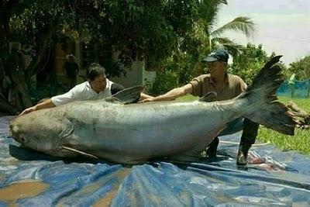
Siluriformes
Pseudobagrus fulvidraco 黄颡鱼
Silurus asotus 鲇
Pangasianodon gigas 湄公河巨鲇
(Mekong giant catfish)

Slide 23
Characiformes
Pygocentrus nattereri 食人鲳 (Piranha)

